Slide 1
Business Intelligence
Lecture 4

Slide 2
SQL – DML and DDL

Slide 3
SQL - Structured Query Language
Query Language
Table Oriented
Fast and Easy access to our data
CRUD - Create, Read, Update, Delete

Slide 4
SQL
DML - Data Manipulation Language
Select
Insert
Update
Delete
DDL - Data Definition Language
Create
Drop
Alter

Slide 5
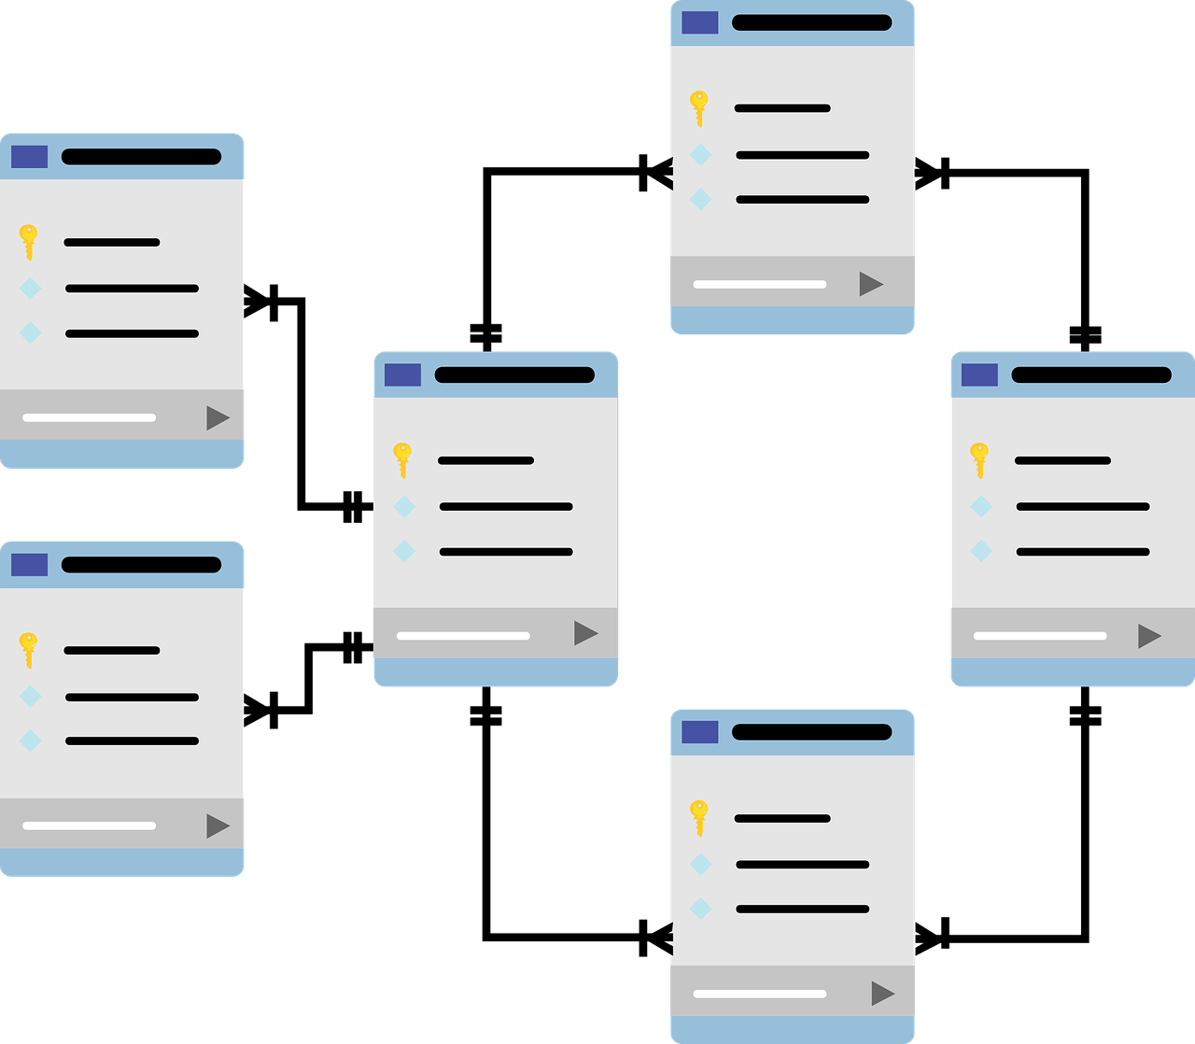
Overview
What happens when we want to handle a few tables which relative
one to each other ?

Slide 6
Courses
StudentID | CourseNumber | CourseName | Grade
111 | 289 | DB | 96
111 | 281 | Algo | 85
222 | 281 | Algo | 78
Foreign Key
Students
FirstName | LastName | StudentID
Avi | Cohen | 111
Dan | Israeli | 222
Ofer | Bar | 333
Primary Key

Slide 7

How to merge two tables ? - Option 1
SELECT FirstName, CourseName, Grade
FROM Students as S, Courses as C
Where (S.StudentID = C.StudentID) and (C.CourseName = ‘Algo’)

Slide 8

How to merge two tables ? - Option 2
SELECT FirstName, CourseName, Grade
FROM Students as S JOIN Courses as C
ON S.StudentID = C.StudentID
Where (C.CourseName = ‘Algo’)

Slide 9
ON VS. USING
When using JOIN statement we need to understand according to which column we want to join the tables.
We will use ON when the columns name is not equal.
We will use USING when the columns name is equal.

Slide 10

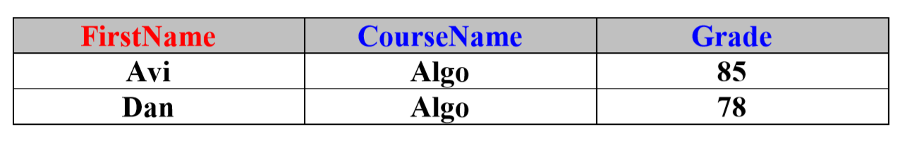
How to merge two tables ? - Option 3
SELECT FirstName, CourseName, Grade
FROM Students JOIN Courses
USING (StudentID)
Where (CourseName = ‘Algo’)

Slide 11
JOIN Types
INNER JOIN
OUTER JOIN
LEFT OUTER JOIN
RIGHT OUTER JOIN
FULL OUTER JOIN

Slide 12
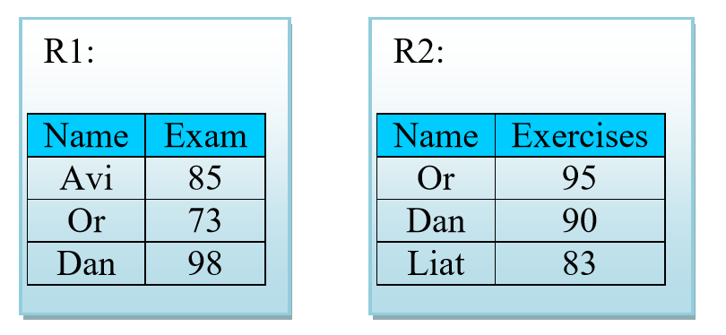
Let’s start with an example..
Given 2 Table called R1, R2:
Mutual column is “Name”

Slide 13
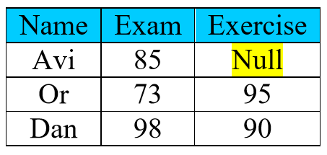
LEFT OUTER JOIN
What happens here? Why Avi has “null” value?
What happens if we use only “JOIN”?

Slide 14
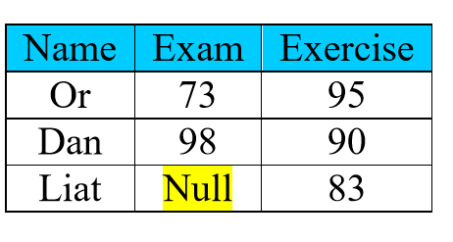
RIGHT OUTER JOIN
What happens here? Why Avi has “null” value?
What happens if we use only “JOIN”?

Slide 15
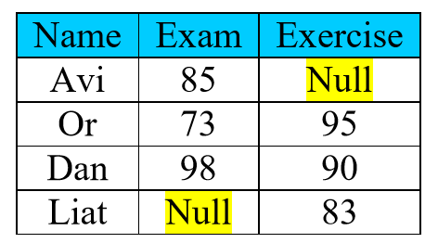
FULL OUTER JOIN
What happens here? Why Avi has “null” value?
What happens if we use only “JOIN”?

Slide 16
Handling NULL values
Sometimes part of our data is NULL, from many reasons:
Result of left/right/full outer join
Missing data while insert a new row
etc.
What if we want to know who is the problematic data?

Slide 17
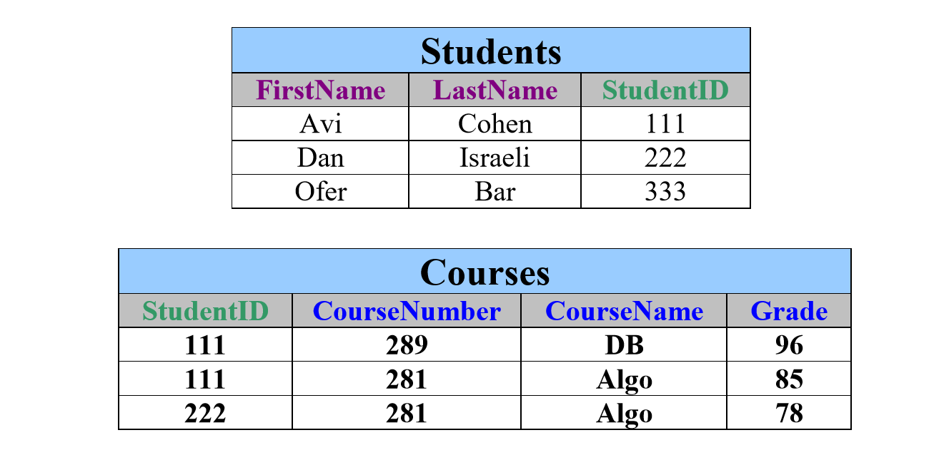
Example
Given 2 simple tables (Student and Courses, the favorite example):

Slide 18
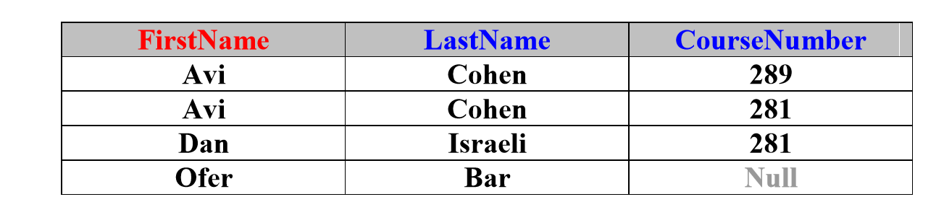
Example
SELECT FirstName, LastName, CourseNumber
FROM Student LEFT OUTER JOIN Courses
USING (StudentID)

Slide 19
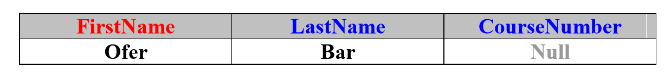
Example
We store the previous query on new table called NewCourses.
SELECT *
FROM NewCourses
WHERE CourseNumber is NULL

Slide 20
Important Notes
As we use “is NULL” , we can use “is NOT NULL”.
Wrong Usage: FirstName = ‘NULL’
NULL is not a String!

Slide 21
CREATE Tables
CREATE TABLE table_name
(
column_name1 data_type,
column_name2 data_type,
column_name3 data_type,
...
)

Slide 22
1 - Define your table schema + types
CREATE TABLE Students
(
Id int NOT NULL,
First_Name text,
Last_Name text,
Birth_Date date,
Hour_Salary float
)

Slide 23
2 - Insert Values (with the same order!)
INSERT INTO Students
VALUES(123456789, ‘Israel’, ‘Israeli’, ‘1980-03-20’, 120.40)

Slide 24
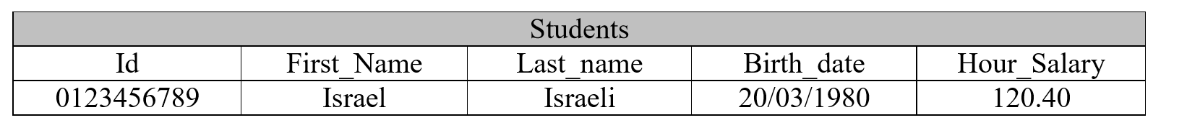
3 - Check your Insertion
SELECT *
FROM Students

Slide 25
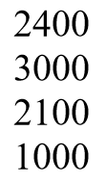
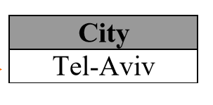
SubQuery with ALL
We want to find the city name where all amounts bigger (or equals) than all average amount of all cities.
SELECT City
FROM Students
GROUP BY City
HAVING AVG(Amount) >= ALL (SELECT AVG(Amount)
FROM Students
GROUP BY City)

Slide 26
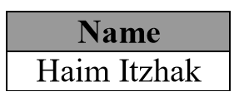
SubQuery with IN
We want to find all names which lives in one of the following cities: Eilat, Haifa, Jerusalem.
SELECT Name
FROM Students
WHERE City IN (‘Eilat’, ‘Haifa’, ‘Jerusalem’)

Slide 27
SubQuery with EXIST
What is the output of the following query?
SELECT SUM(Amount)
FROM Students
WHERE EXISTS (SELECT *
FROM AgudaMembers as AM
WHERE AM.Name = Students.Name)

Slide 28
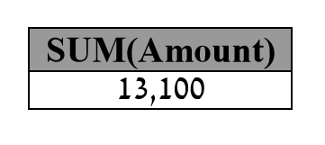

Slide 29
Window Functions

Slide 30
What is Window Functions?
Window functions are used to perform a calculation on an aggregate value based on a set of rows and return multiple rows for each group.
The window word represents the group of rows on which the function will be operated.
Performs a calculation in the same way that the aggregate functions would perform.
Window functions work on a group of rows and return a total value for each row. As a result, each row retains its distinct identity.

Slide 31
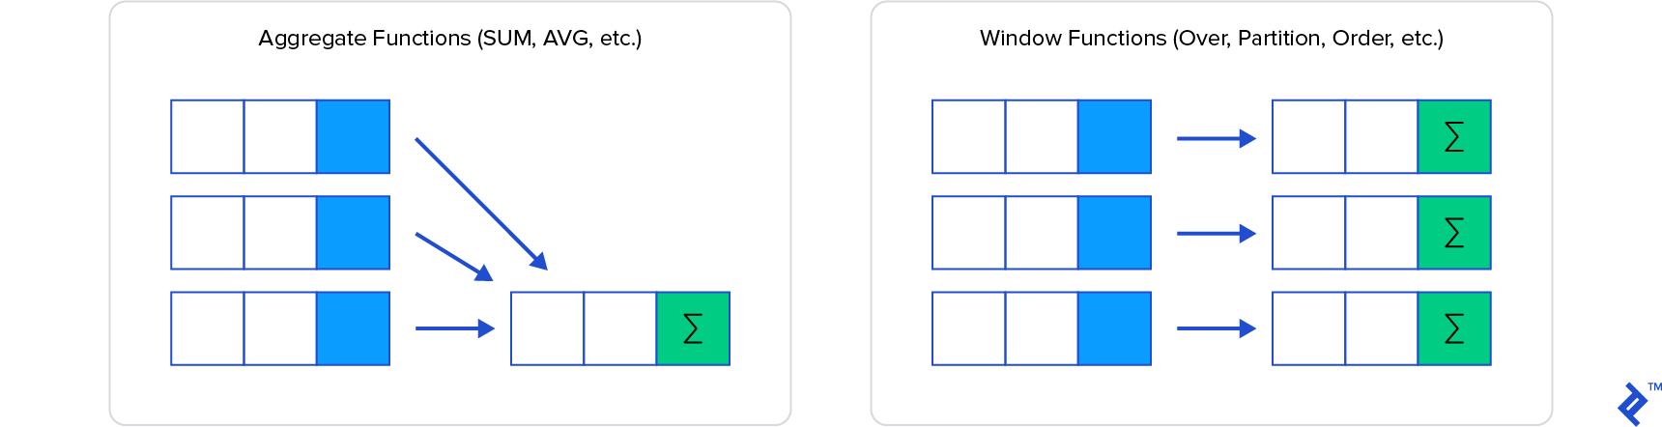
What is Window Functions?

Slide 32
Syntax
window_function: It indicates the name of your window function.
ALL (optional): count all values along with duplicates. We cannot use the DISTINCT keyword in window functions.
Expression: the column name for which we calculate an aggregated value.
window_function_name([ALL] expression)
OVER (
[partition_defintion]
[order_definition]
)

Slide 33
Syntax
OVER: It specifies the window clauses for aggregate functions.
PARTITION BY: This clause divides the rows into partitions, and then a window function is operated on each partition.
ORDER BY: It is used to specify the order of rows within each partition.
When this clause is not defined, SQL Server will use the ORDER BY for the entire table.

Slide 34
Window Functions Types
Aggregate Window Functions
Operated on multiple rows. SUM(), MAX(), MIN(), AVG(), COUNT(), etc.
Ranking Window Functions
Ranks each row of a partition in a table.
RANK(), DENSE_RANK(), ROW_NUMBER(), NTILE(), etc.
Value Window Functions
Locally represented by a power series.
LAG(), LEAD(), FIRST_VALUE(), LAST_VALUE(), etc.

Slide 35
Example – Sales Table
CREATE TABLE Sales(
Employee VARCHAR(45) NOT NULL,
Year INT NOT NULL,
Country VARCHAR(45) NOT NULL,
Product VARCHAR(45) NOT NULL,
Amount DECIMAL(12,2) NOT NULL,
PRIMARY KEY(Employee, Year)
);

Slide 36
Aggregration Window Functions

Slide 37
Example – Sum
Result: aggregates the data for each country and displays the sum of total sales for each of them. It also inserts another column for the total sales as Total so that each row retains its identity.
SELECT Employee, Year, Country, Product, Amount, SUM(Amount)
OVER(PARTITION BY Country) as Total
FROM Sales

Slide 38
Example – Sum
Employee | Year | Country | Product | Amount | Total
Or Peretz | 2017 | Israel | Computer | 15000 | 45000
Or Peretz | 2018 | Israel | Computer | 10000 | 45000
Or Peretz | 2019 | Israel | TV | 20000 | 45000
Omer Doron | 2018 | USA | TV | 20000 | 30000
Omer Doron | 2019 | USA | Mobile | 10000 | 30000

Slide 39
Example – Avg
Result: produce the average sales for each country and each year. Here we have specified more than one average by specifying multiple fields in the partition list.
SELECT Employee, Year, Country, Product, Amount, AVG(Amount)
OVER(PARTITION BY Country, YEAR(Year)) as AvgSales
FROM Sales;

Slide 40
Example – Avg
Employee | Year | Country | Product | Amount | AvgSales
Or Peretz | 2017 | Israel | Computer | 15000 | 15000
Or Peretz | 2018 | Israel | Computer | 10000 | 15000
Or Peretz | 2019 | Israel | TV | 20000 | 15000
Omer Doron | 2018 | USA | TV | 20000 | 15000
Omer Doron | 2019 | USA | Mobile | 10000 | 15000

Slide 41
Example – Count
The count function will return the total number of rows or records present in the table or group. The regular aggregate function uses the DISTINCT keyword not to count the duplicates rows. But the window count function does not support this keyword.
SELECT Employee, Year, Country, Product, Amount, COUNT(Product)
OVER(PARTITION BY Country) As TotalProduct
FROM Sales;

Slide 42
Example – Max
This function returns the maximum value for a specified group. When we have not defined the group, it will return the maximum value for the entire table.
SELECT Employee, Year, Country, Product, Amount, MAX(Product)
OVER(PARTITION BY Country) As TotalProduct
FROM Sales;

Slide 43
Ranking Window Functions

Slide 44
Ranking Window Functions
The RANKING function ranks the values in a defined column and categorizes them based on their rank. The following are the ranking functions supported in SQL Server:
RANK(), DENSE_RANK(), ROW_NUMBER(), and NTILE().
Data for examples:
FirstName | LastName | City
Luisa | Evans | Texas
Paul | Ward | Alaska
Peter | Bennett | California
Carlos | Patterson | New York
Rose | Huges | Florida
Marielia | Simmons | Texas
Antonio | Butler | New York
Diego | Cox | California

Slide 45
Example – Rank
It's used to generate a unique rank for each row in a table based on the specified value.
If this function gets the two records with the same value, it will assign the same rank to both records and skip the next ranking.
SELECT FirstName, LastName, City,
RANK () OVER (ORDER BY City) AS RankNo
FROM table;

Slide 46
Example – Rank
FirstName | LastName | City | RankNo
Paul | Ward | Alaska | 1
Peter | Bennett | California | 2
Diego | Cox | California | 2
Rose | Huges | Florida | 4
Carlos | Patterson | New York | 5
Antonio | Butler | New York | 5
Luisa | Evans | Texas | 7
Marielia | Simmons | Texas | 7

Slide 47
Example – Dense Rank
It works the same as the RANK() function except that it does not skip any rank. It always assigns rank in consecutive order. It means that when two records are found equal, this function will assign the same rank to both records and the next rank being the next sequential number.
SELECT FirstName, LastName, City,
DENSE_RANK() OVER (ORDER BY city) AS RankNo
FROM table

Slide 48
Example – Dense Rank
FirstName | LastName | City | RankNo
Paul | Ward | Alaska | 1
Peter | Bennett | California | 2
Diego | Cox | California | 2
Rose | Huges | Florida | 3
Carlos | Patterson | New York | 4
Antonio | Butler | New York | 4
Luisa | Evans | Texas | 5
Marielia | Simmons | Texas | 5

Slide 49
Example – Ntile
This window function distributes rows into a pre-defined number (N) of approximately equal groups. It enables us to determine which percentile (or quartile, or other subdivision) a particular row belongs to.
SELECT FirstName, LastName, City,
NTILE(3) OVER ( ORDER BY city) AS RankNo
FROM table

Slide 50
Example – Ntile
FirstName | LastName | City | RankNo
Paul | Ward | Alaska | 1
Peter | Bennett | California | 1
Diego | Cox | California | 1
Rose | Huges | Florida | 2
Carlos | Patterson | New York | 2
Antonio | Butler | New York | 2
Luisa | Evans | Texas | 3
Marielia | Simmons | Texas | 3

Slide 51
Value Window Functions

Slide 52
Value Window Functions
The LEAD and LAG functions are used to get the preceding and succeeding values of specified rows from the current row within its partition.
CREATE TABLE Sales(
Employee VARCHAR(45) NOT NULL,
Year INT NOT NULL,
Country VARCHAR(45) NOT NULL,
Product VARCHAR(45) NOT NULL,
Amount DECIMAL(12,2) NOT NULL,
PRIMARY KEY(Employee, Year)
);

Slide 53
Example - Lead
Result: returns the amount and next amount detail of each employee.
It first split the result based on the year and then sorted each partition using the country column.
LEAD() - function on each partition to get the next sales detail.
SELECT Year, Product, Country, Amount,
LEAD(Amount,1) OVER (PARTITION BY Year ORDER BY Country) AS NextAmount
FROM Sales

Slide 54
Example - Lead
Year | Product | Country | Amount | NextAmount
2017 | Computer | Canada | 15000 | 10000
2017 | Laptop | Israel | 10000 | 20000
2017 | TV | Israel | 20000 | NULL
2018 | TV | Canada | 20000 | 10000
2018 | Mobile | USA | 10000 | NULL

Slide 55
Example - Lad
Result: returns the amount and previous amount detail of each employee.
It first split the result based on the year and then sorted each partition using the country column.
Lad() - function on each partition to get the previous sales detail.
SELECT Year, Product, Country, Amount,
LAG(Amount, 1) OVER (PARTITION BY Year ORDER BY Country) AS PrevAmount
FROM Sales

Slide 56
Example - Lad
Year | Product | Country | Amount | NextAmount
2017 | Computer | Canada | 15000 | NULL
2017 | Laptop | Israel | 10000 | 15000
2017 | TV | Israel | 20000 | 10000
2018 | TV | Canada | 20000 | NULL
2018 | Mobile | USA | 10000 | 20000

Slide 57
First and Last Values
These functions are used to find the first and last record in the table or a partition if the PARTITION BY clause is specified.
Note: these functions are mandatory to use the ORDER BY clause.
SELECT Year, Product, Country, Amount,
FIRST_VALUE(Amount) OVER(PARTITION BY Country ORDER BY Country) FirstAmount,
LAST_VALUE(Amount) OVER(PARTITION BY Country ORDER BY Country) LastAmount
FROM Sales

Slide 58
First and Last Values
Year | Product | Country | Amount | FirstAmount | LastAmount
2017 | Computer | Canada | 15000 | 15000 | 10000
2018 | Laptop | Canada | 10000 | 15000 | 10000
2017 | TV | Israel | 10000 | 10000 | 20000
2018 | TV | Israel | 15000 | 10000 | 20000
2019 | Mobile | Israel | 20000 | 10000 | 20000

